Slide 1
MUHAMMAD AKBAR HAMID
Submission Akhir: Menyelesaikan Permasalahan Institusi Pendidikan
Belajar Penerapan Data Science | Dicoding

Slide 2
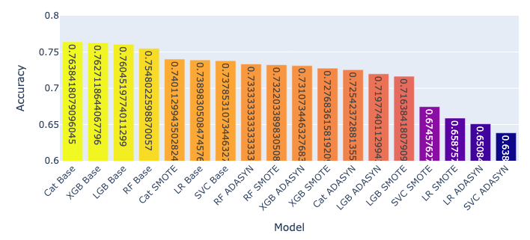
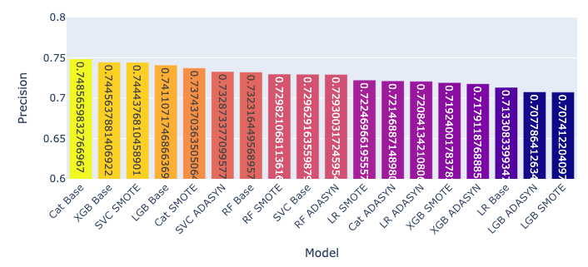
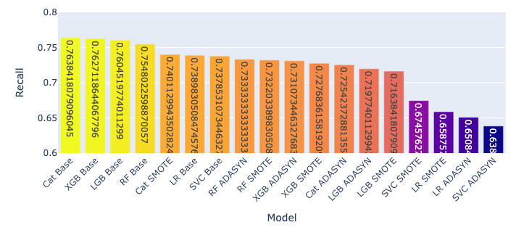
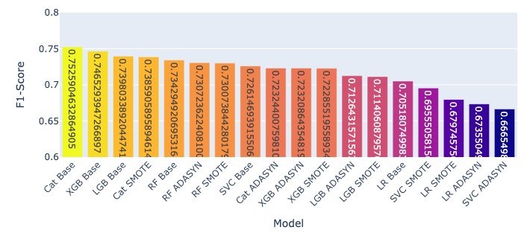
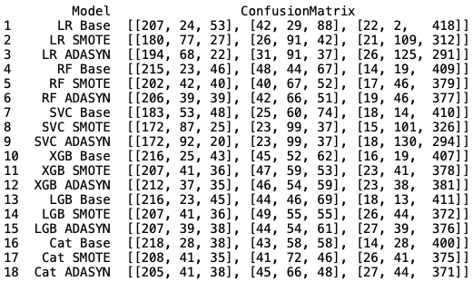
Feature Selection:
Pemilihan berdasarkan Chi²-LR & manual yang relevan dengan peringkat χ² score.
Application_mode,
Age_at_enrollment,
Curricular_units_1st_sem_approved,
Curricular_units_1st_sem_grade,
Curricular_units_2nd_sem_approved,
Curricular_units_2nd_sem_grade,
Debtor,
Displaced,
Gender,
Marital_status,
Previous_qualification,
Scholarship_holder, &
Tuition_fees_up_to_date.
Evaluation:
Accuracy
Recall
Precision
F1-Score
Model:
Logistic Regression
LR Base
LR + SMOTE
LR + ADASYN
Random Forest
RF Base
RF + SMOTE
RF + ADASYN
Support Vector Machine (SVC)
SVC Base
SVC + SMOTE
SVC + ADASYN
XGBoost
XGB Base
XGB + SMOTE
XGB + ADASYN
LightGBM
LGB Base
LGB + SMOTE
LGB + ADASYN
CatBoost
CatBoost Base
CatBoost + SMOTE
CatBoost + ADASYN
Confusion Matrix

Slide 3
Kesimpulan:
Data-driven solution
Proyek membuktikan data science efektif menurunkan risiko dropout.
Model terbaik
CatBoost tanpa penanganan ketidakseimbangan data.
Dashboard & prototype
Looker Studio memudahkan monitoring tren dan karakteristik mahasiswa.
Streamlit app siap pakai untuk prediksi risiko individual.
Manfaat
Deteksi dini mahasiswa berisiko tinggi
Fondasi pengambilan keputusan berbasis data
Rekomendasi Penyelesaian Masalah:
Early Warning System
Jalankan Model ML (CatBoost) untuk deteksi probabilitas dropout → rujuk bimbingan.
Intervensi Berdasarkan Risiko
70% → bimbingan intensif
50 – 70% → sesi konsultasi
< 50% → pemantauan rutin
Bimbingan Akademik & Finansial
Fokus pada fitur krusial (GPA awal, beasiswa, status debitur).
Pelatihan Staf
Sosialisasi dashboard & interpretasi skor risiko ke dosen/konselor.
Evaluasi & Update Model
Review performa berkala, fine-tuning sesuai data terbaru.

Slide 4
MATUR NUWUN~
Github : https://github.com/muhakbarhamid21/student-dropout-prediction
Streamlit : https://muhakbarhamid21-prediksi-dropout-mahasiswa.streamlit.app
Muhammad Akbar Hamid | muhakbarhamid21@gmail.com
https://www.linkedin.com/in/muhakbarhamid21 | https://github.com/muhakbarhamid21

